Slide 1
Government Responsibilities

Slide 2
How does government affect your life?
?

Slide 3
Record Your Thoughts
Complete the first section of your "I used to think, I Now Think" organizer before beginning this lesson.

Slide 4
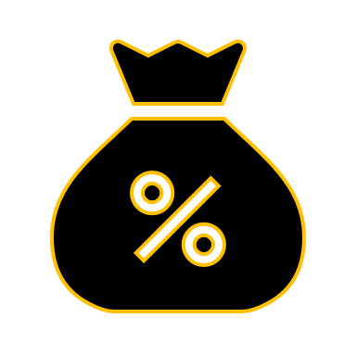
Background
There are many levels of government in Canada: municipal (city), provincial/territorial (province or territory) and federal (country).
Political negotiations have also established some powers of self-government for individual communities of First Nations and Inuit in Canada over government responsibilities like education, health, marriage, taxation and housing.

Slide 5
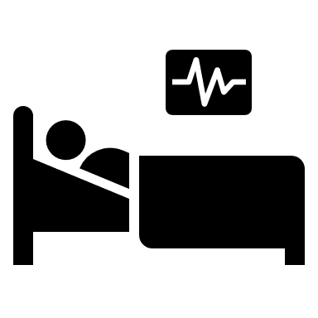
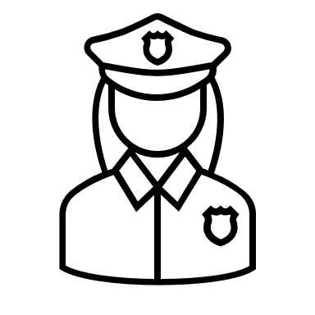
Examples of Government Responsibilities
- health care
- law enforcement
- education
- housing
- taxation
- transportation
​
Which ones affect your life?

Slide 6
Levels of Government Canada is a federalist government. This means there is more than one level of government.
Federal Government
This is the level of government for the whole country. The political party that won the last election with the most seats sits in the House of Commons with the Prime Minister as the leader.
Provincial/Territorial Government
Every province and territory has a legislature where government members work and make laws and policies. The head of the government is called the Premier and is the leader of the party with the most seats.
Municipal Government
Cities, towns, or districts are called municipalities and have a council that makes laws and policies. The members are elected by the residents. There are no political parties.

Slide 7
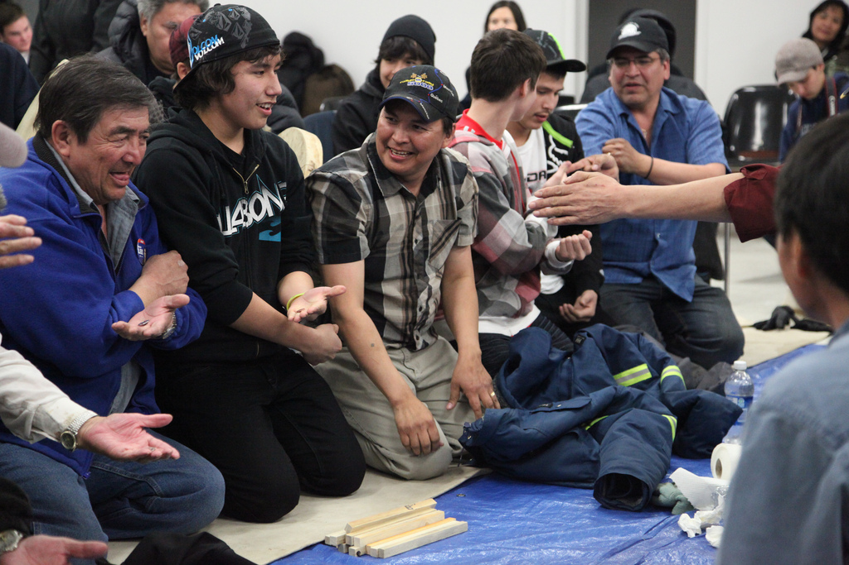
First Nations Governance
Across the country, band councils govern First Nations communities. Band members elect the band council, which makes decisions that affect their local community. This is like a municipal government.
Many First Nations powers and responsibilities are still in negotiation and are shared between the federal government (Indian and Northern Affairs Canada) and First Nations.
Source: Government of Canada
Government of Manitoba
On 1 September 2016, the Délįnę Got’įnę Government achieved the right to self-government.
Image courtesy of reelyouth/FlickrCC

Slide 8
Activity
In your group, sort the government responsibility cards into 3 piles:
Municipal (city, town, district)
Provincial (Ontario)
Federal (Canada)
​
Did you know?
Across the country, band councils govern some First Nations communities. Band members can elect the band council, which makes decisions that affect their local community.

Slide 9
WHO DOES WHAT?
PRESS PLAY

Slide 10
Shared Government Responsibilities
Transportation Communication Immigration
Human Rights
Marriage/Divorce
Laws
Shared Government Responsibilities
The responsibilities are set out in the Constitution of Canada.
The federal government has power over matters that affect all Canadians and cross provincial and international borders.
The provincial and territorial governments deal with matters that are local to the region.
Municipal governments are set up by the provincial legislatures, so they only have the powers that the province gives them.
Some areas of responsibility are shared by both levels of government. For example, the federal government has the power to control movement across provincial or international borders by plane, train and automobile but the provinces look after provincial highways, registering vehicles and licensing drivers, and driver licensing.

Slide 11
Pause and Think
Have your thoughts changed because of what you have learned so far in the lesson?
Record what you are thinking about the question in the second part of your organizer.
Start your sentences with:
“I am now thinking…”;
“Here’s what I am thinking so far…”;
“I had a hunch that…and it looks like I am on the right track because…”;
“What I am now thinking is very different from what I used to think because…”

Slide 12
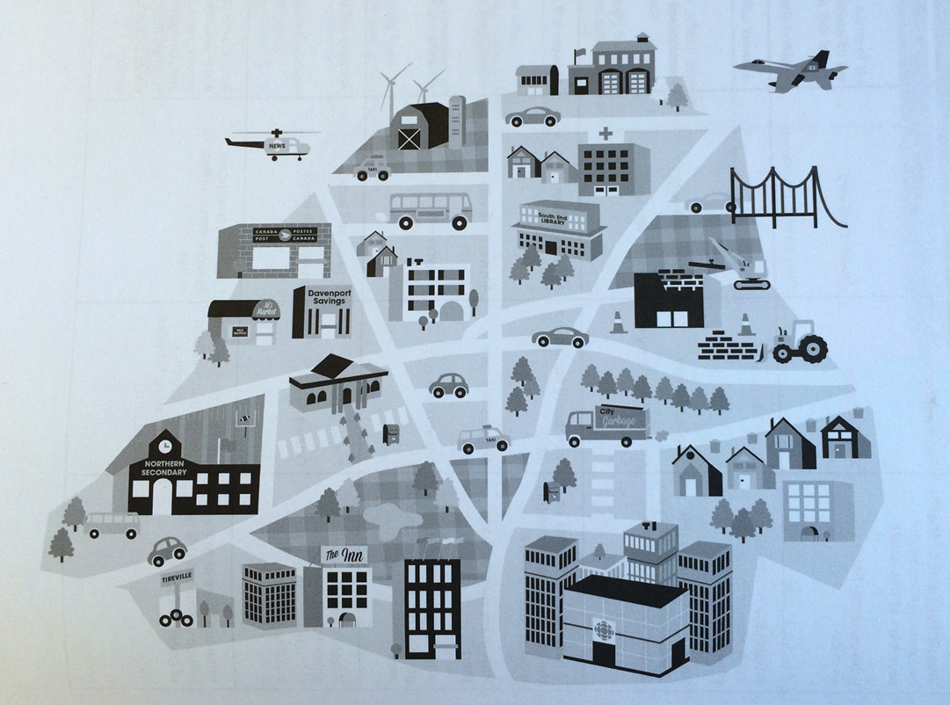
Activity - 2
In your group, label the various government responsibilities in the picture:
Municipal (city, town, district)
Provincial (Ontario)
Federal (Canada)
​

Slide 13
FINALIZE YOUR THINKING
You are now ready to finish the thinking protocol on your organizer.
Complete the last section, 'I Now Think' to capture your learning.

Slide 14
Glossary
Constitution of Canada: the supreme law of Canada, it outlines the system of government and division of powers.
council: local elected authorities in cities, towns, villages that provide local services and raise revenue through property taxes and provincial grants.
House of Commons: centre of political power in Canada. It consists of a Speaker, the prime minister and his or her Cabinet, members of the governing party, members of the opposition parties and the Official Opposition's shadow government, and backbenchers.
legislature: An officially elected or otherwise selected body of people vested with the responsibility and power to make laws for a political unit, such as a province or nation.
Premier: The head of provincial or territorial government.
Prime Minister: The head of the Cabinet and often also the chief executive of a parliamentary democracy. Leader of our Canadian federal government.

Slide 15
Last Page
All images in this slide deck are licensed through Creative Commons.

