Slide 1

Principles of Democracy

Slide 2

De·moc·ra·cy a system of government by the whole population or all the eligible members of a state, typically through elected representatives.
?

Slide 3
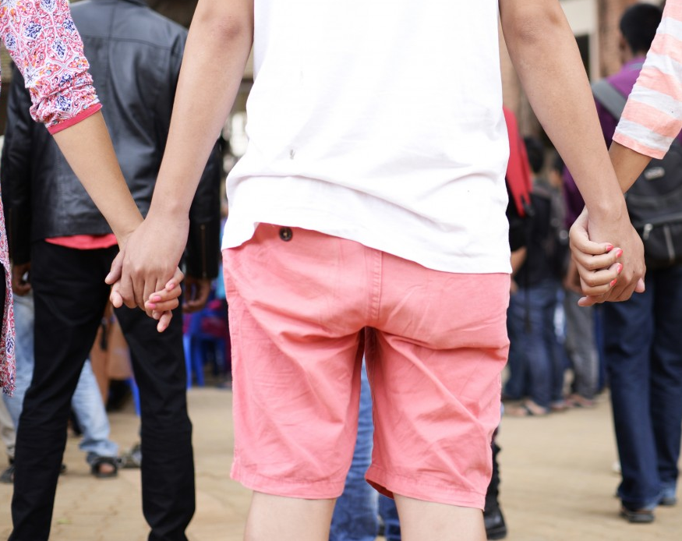
Common Good
Democratic citizens should work together and seek solutions that promote safety, security and happiness for all members.

Slide 4
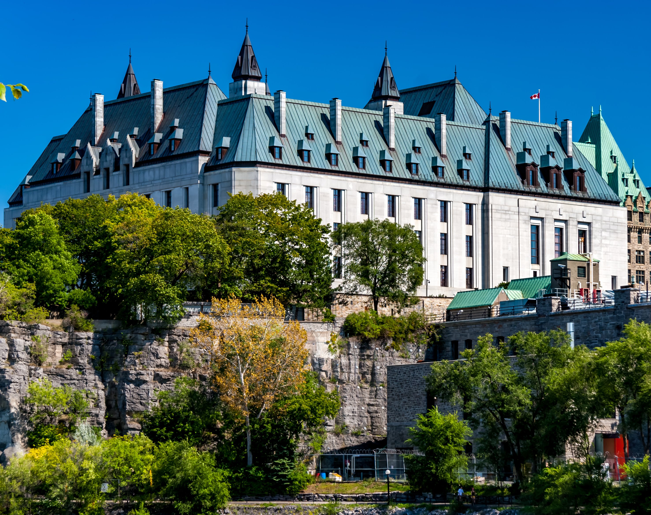
Rule of Law
Rule of Law
In a democracy, everyone is subject to the same laws, even those that are in power like the Prime Minister. Laws are written down, fair and impartial. Everyone receives fair treatment by the police and the courts.
In a democracy, everyone is subject to the same laws, even those that are in power like the Prime Minister. Laws are written down, fair and impartial. Everyone receives fair treatment by the police and the courts.
Supreme Court of Canada

Slide 5
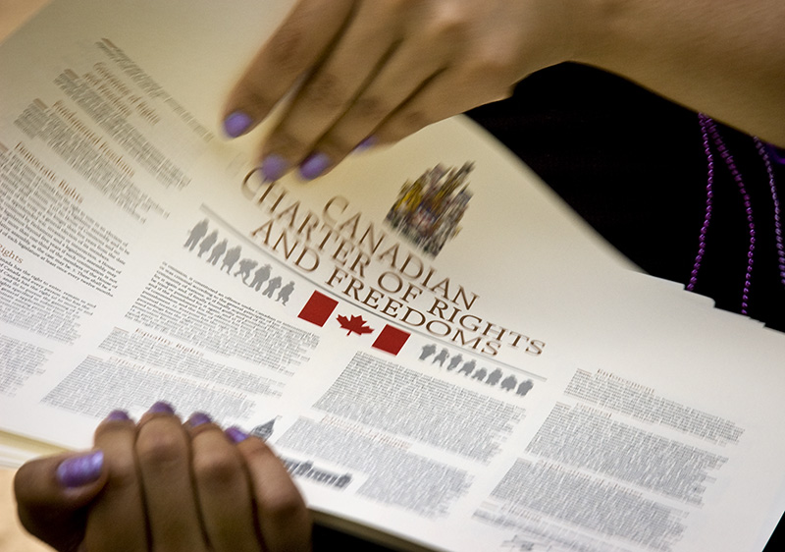
Personal Freedoms
In a democracy, people have personal freedoms such as freedom of expression, religion and association. These freedoms are written down (codified) and the government cannot unjustly take them away.

Slide 6
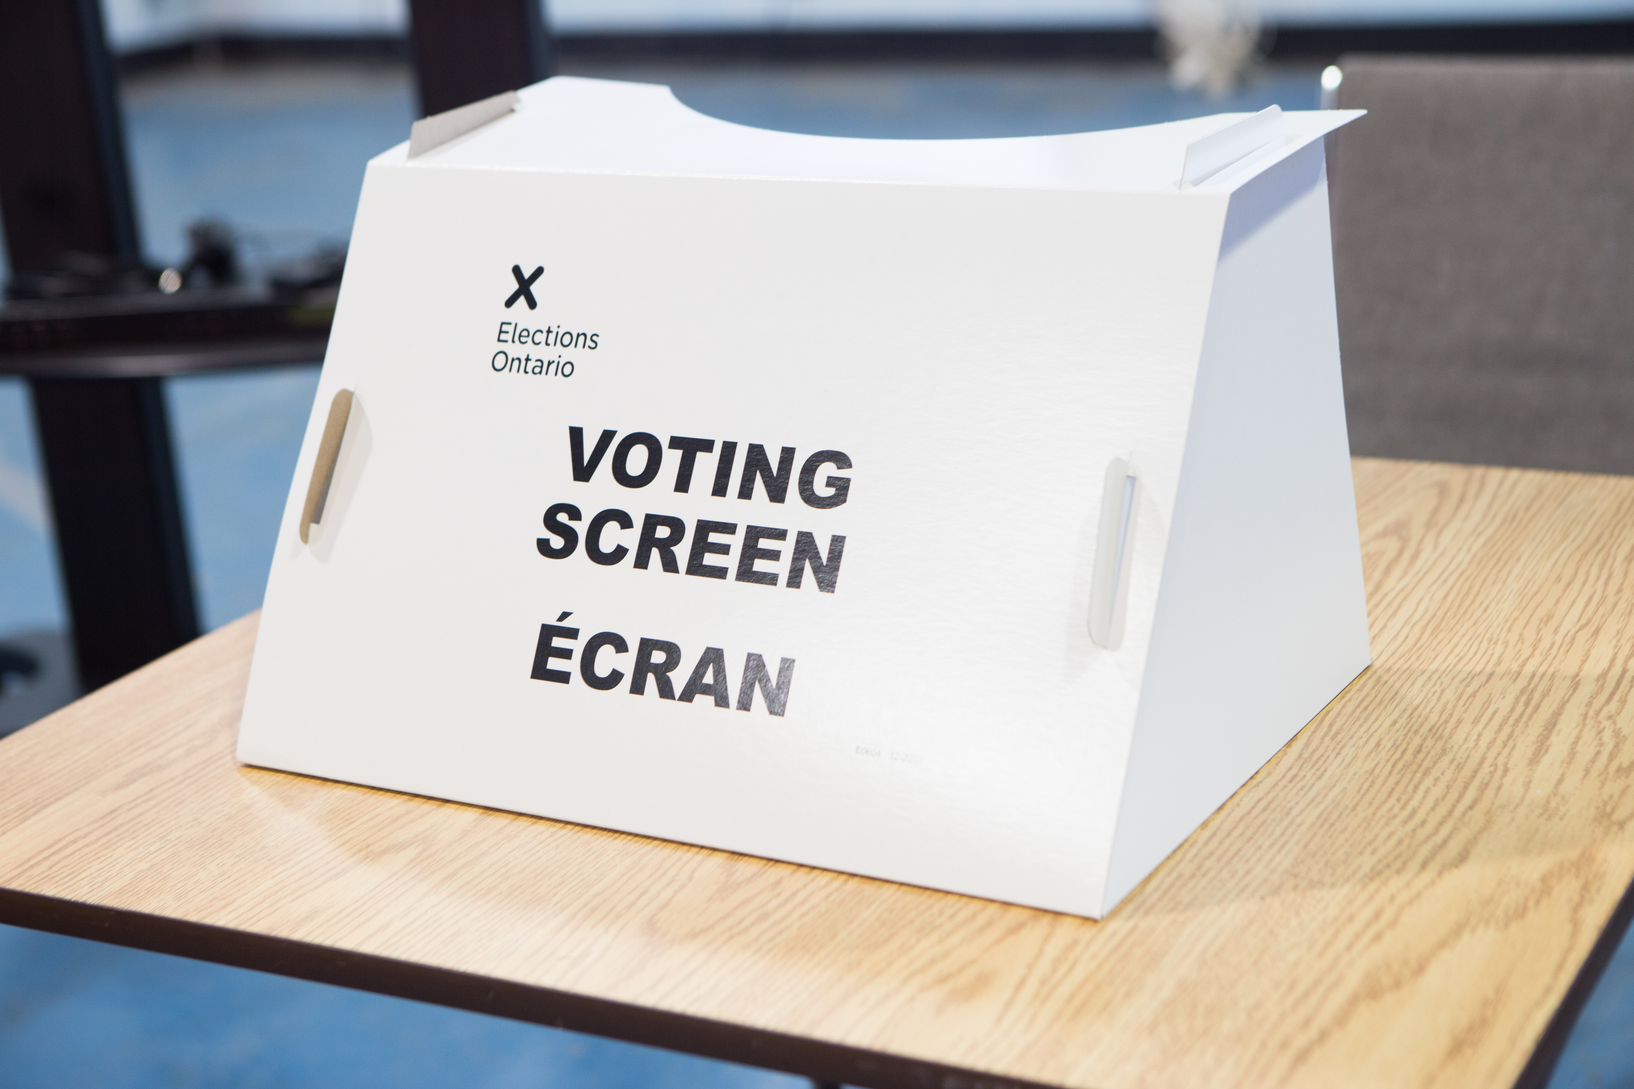
Political Equality
Political Equality
Every citizen has equal rights to vote and to run for election. Every citizen has a political voice and the right to speak on public issues.
Every citizen has equal rights to vote and to run for election. Every citizen has a political voice and the right to speak on public issues.

Slide 7
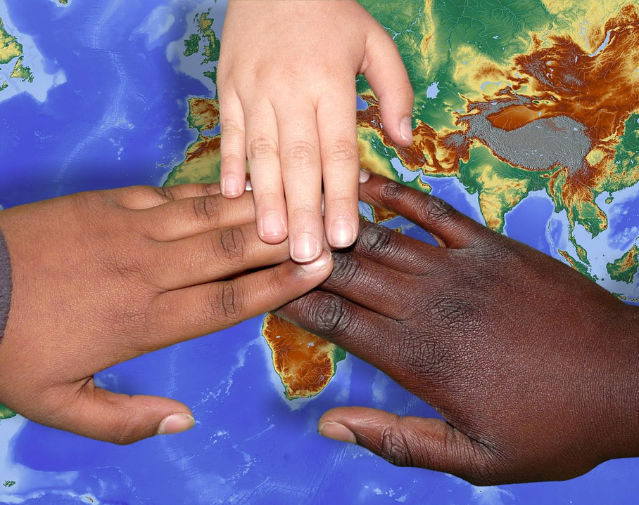
Human Dignity
Democratic countries uphold and protect the dignity of all people. Democratic governments do this by guaranteeing that all people are treated equally. Equality is often achieved through the rule of law.

Slide 8
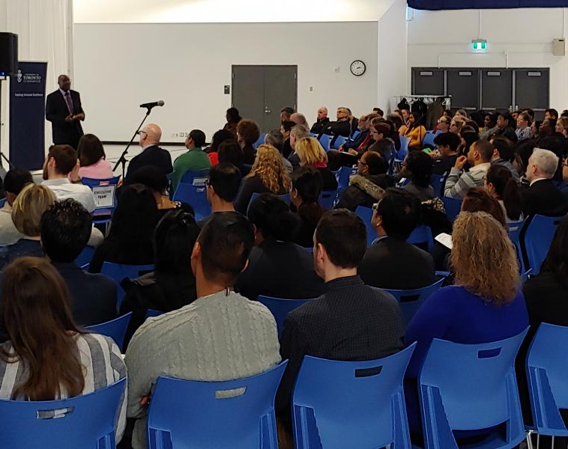
Citizen Participation
Being informed and getting involved is a foundational concept of democracy. Democratic citizens should participate by informing
themselves of and acting on issues that affect their lives and the lives of others. This is a right and a responsibility.

Slide 9
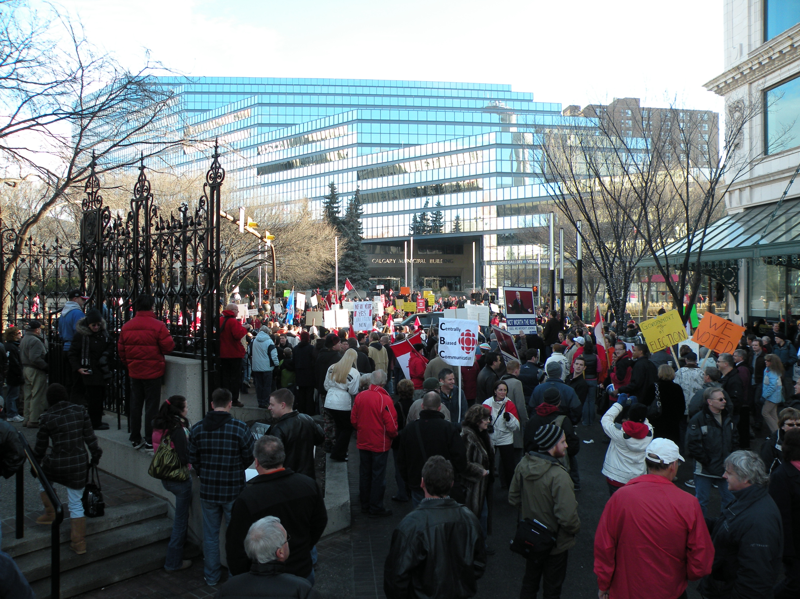
Tolerance and Respect
Democratic citizens respect the rights of others. Democracies do rely on the concept of the "majority rule", but the rights of the minority are also protected. Democracies respect different ideas and viewpoints. To achieve the common good, respect for all people is needed. In democracies, political discussions and debates are encouraged.

Slide 10
Last Page
All images in this slide deck are licensed through Creative Commons.

